Slide 1
Systemic training for medical students October 2018
Please refer to “Salome Scholtens, Dept of Health Sciences, University Medical Center Groningen, the Netherlands” when used. See more info at: www.seedsandleaves.nl
s.scholtens@umcg.nl

Slide 2
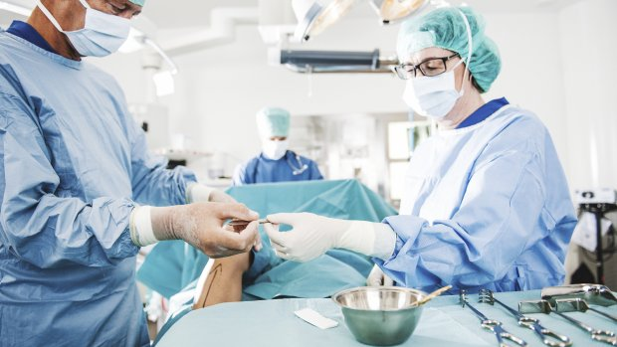
Content
Background and context
How the project came about
What we did do?
Results
Challenges and puzzles
Planned future steps

Slide 4
Background
High burn-out and depression rate among (young) doctors and students. Call for medical leadership.
Set-up ‘Leadership in Practice’ educational line in medical curriculum in Groningen, the Netherlands
Focus on:
Know yourself (self-leadership) Know your environment (systemic-leadership)
Based in Transformative Learning

Slide 5
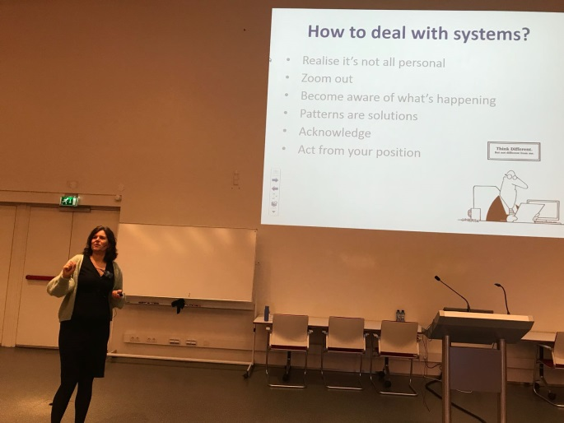
The training
Lecture on systemic perspective in organisations
Two 2-hours workshops
Workshop 1: focus on team work
Workshop 2: focus on roles in the organisation
3rd year medical students

Slide 6
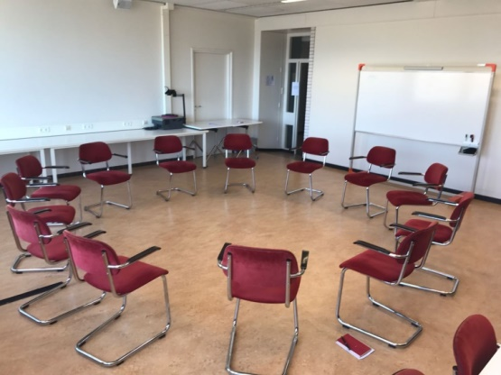
Workshop 1 - team
370 students, 12 students per group
Enrolled with their project team
2 trainers per group
Aim:
Introduce systemic perspective
Experience (become aware) of the systemic
Experience different roles and systems
Create insights how to deal with these different roles and systems

Slide 7
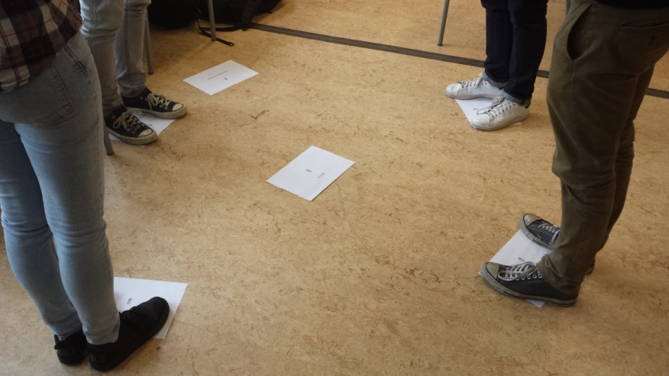
Workshop 2 - organisation
90 students, 12 students per group
Aim:
Experience (become aware) of the roles and positions in the medical system
Experience their role(s) in the system and the interrelation with other roles

Slide 8
Results
Students have tremendous systemic awareness
Overall: very willing to participate
Only short introduction needed
The trainer must be trustworthy
It has to be highly professional

Slide 9
Results
186 students complete the questionnaire
75% female
Right after the workshop
I liked the workshop | %
Number – ‘1=strongly disagree’ (%) | 13.7
Number – ‘2’ (%) | 8.7
Number – ‘3’ (%) | 14.8
Number – ‘4-neither agree not disagree’ (%) | 13.1
Number – ‘5’ (%) | 22.4
Number – ‘6’ (%) | 19.1
Number – ‘7=strongly agree’ (%) | 8.2

Slide 10
Results
 | Not agree | Neutral | Agree
I liked the workshop | 37.2 | 13.1 | 49.7
The workshop gave me useful insights or help with the teamwork | 42.4 | 15.8 | 41.9
The workshop set-up was clear to me | 36.1 | 12.6 | 51.4
The workshop came on the right time during my training | %
Number – ‘too early’ | 6.8
Number – ‘on time’ | 71
Number – ‘too late’ | 22.2
Female students were more positive: 53.6% vs 30.7%
16 students had experience with constellations: no difference in liking

Slide 11
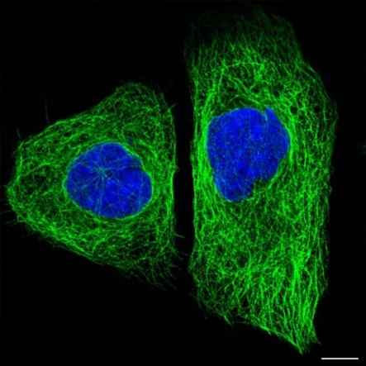
Challenges and puzzles
How to connect with the medical system?
They have experienced stress, pressure, dysfunctional teams, etc
They know about physical systems (systemic diseases)
It’s a practice-based profession
Use to ratio, linearity and causation
Focused, highly motivated, and result driven
Allergy for esoteric methods

Slide 12
Challenges and puzzles
Not on their request. We came to them (delegate clients).
How to motivate the student and get them involved?
Keep it light, airy and lively. It’s easy to get sucked in.
How and when is training effective?
How and where to expand the training?

Slide 13
Future steps (2018-2020)
Training
Continuation in the Bachelor phase
Introduction in the Master phase (co-assistant)
Development of a minor: Leadership in complex environments
Create systemic hub inside UMCG
Train trainers in systemic work in UMCG
Create an expertise group
Connect with leadership training for employees

Slide 14
Future steps
Ongoing
Evaluation of the training effect
English review of the current research publications
Research questions
What is systemic intelligence?
How to study systemic ‘effects’?
How/when is training most effective?
What are the working ingredients?
Research line and blog
www.seedsandleaves.nl

Slide 15
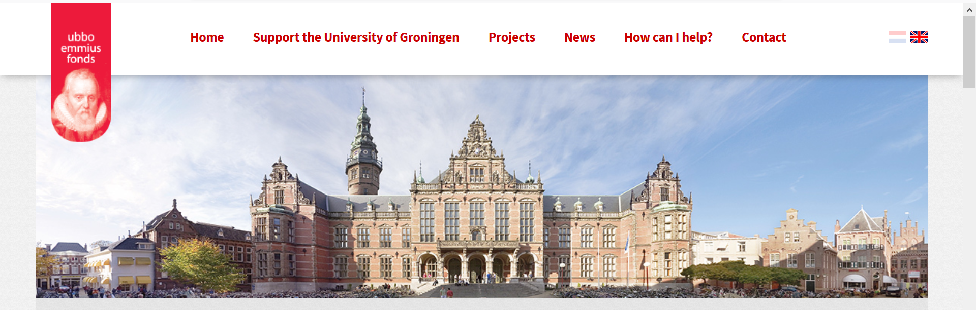
You can support research
www.rugsteunt.nl/project/systemisch-leiderschap

Slide 16
Please refer to “Salome Scholtens, Dept of Health Sciences, University Medical Center Groningen, the Netherlands” when used. See more info at: www.seedsandleaves.nl
Questions?

